Slide 1
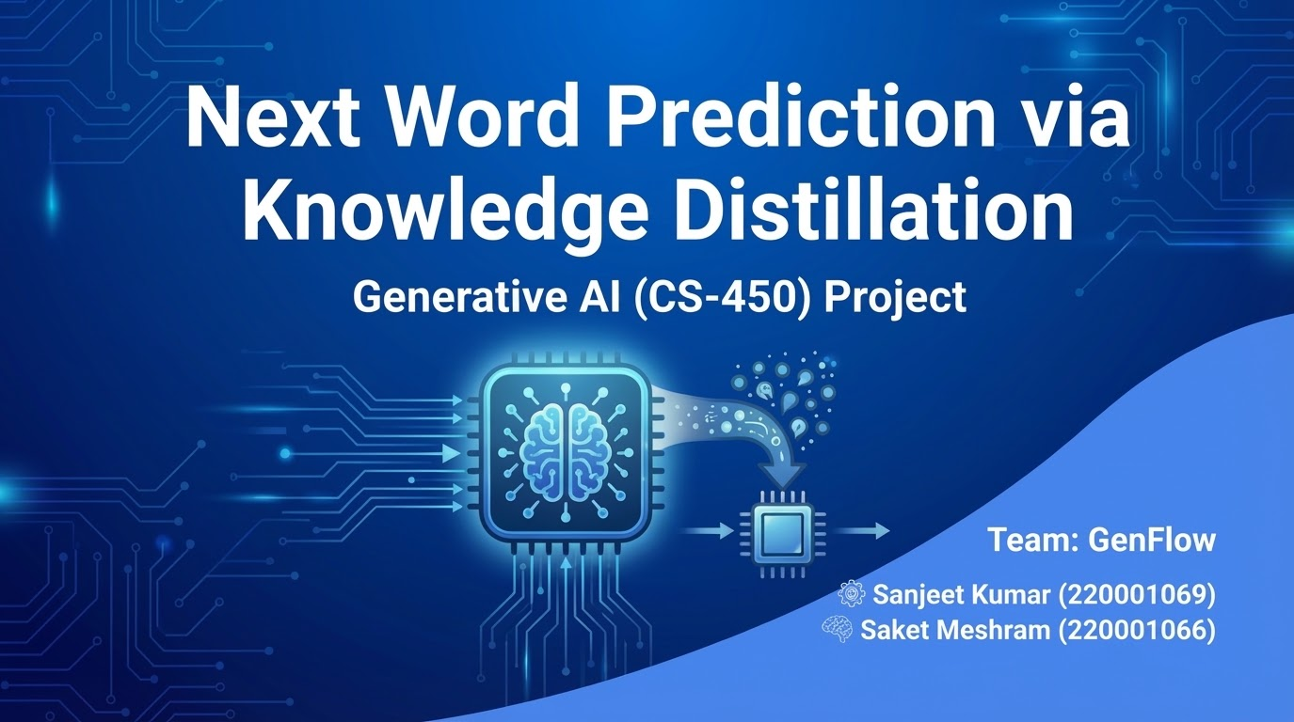

Slide 2
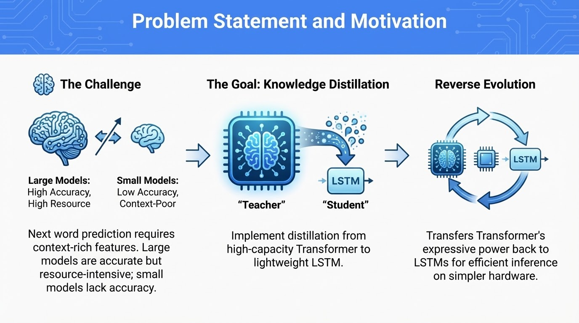

Slide 3
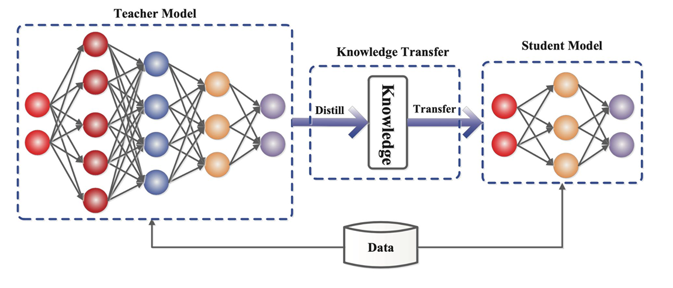
Distillation Pipeline

Slide 4
Workflow
Data Preparation
Load text data, preprocess (remove punctuation, lowercase), tokenize, and pad sequences.
Split into training/validation sets.
Teacher Model (Transformer)
Build and train a transformer with multi-head attention and layer normalization.
Train using cross-entropy loss with adaptive learning rate and early stopping.

Slide 5
Workflow (Contd.)
3. Knowledge Distillation
Teacher: Generate soft labels (probabilistic outputs).
Student: Train a lightweight LSTM using a hybrid loss: Cross-entropy (ground truth) + KL-divergence (teacher guidance).
4. Baseline LSTM
Train a standalone LSTM (same architecture as student) without distillation.
5. Evaluation
Compare validation accuracy of distilled student vs. baseline.
Visualize results to highlight performance gains.

Slide 6
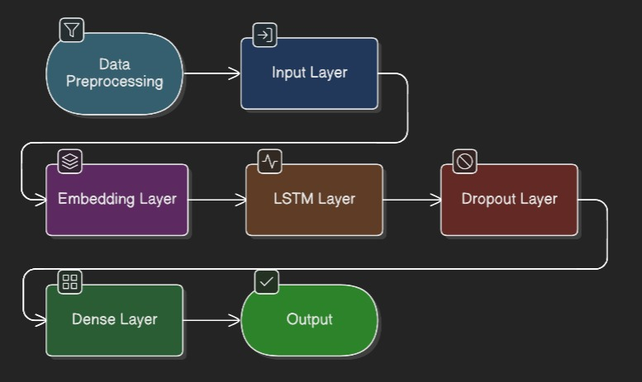
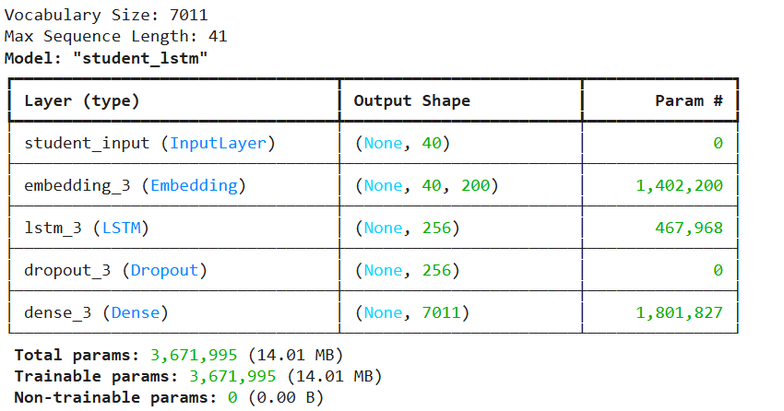
Student LSTM
LSTM Model

Slide 7
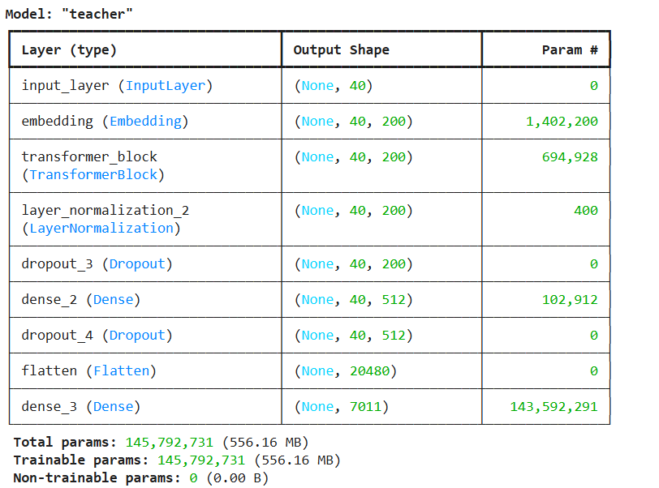
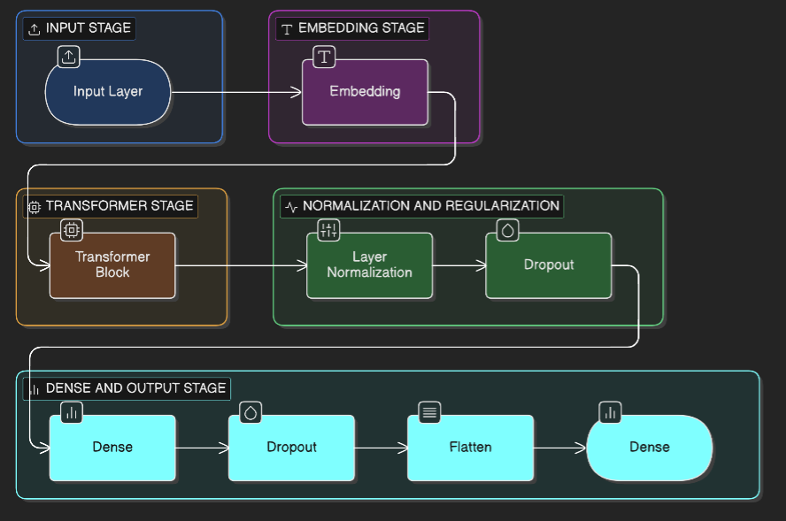
Transformer Model
Transformer Model

Slide 8
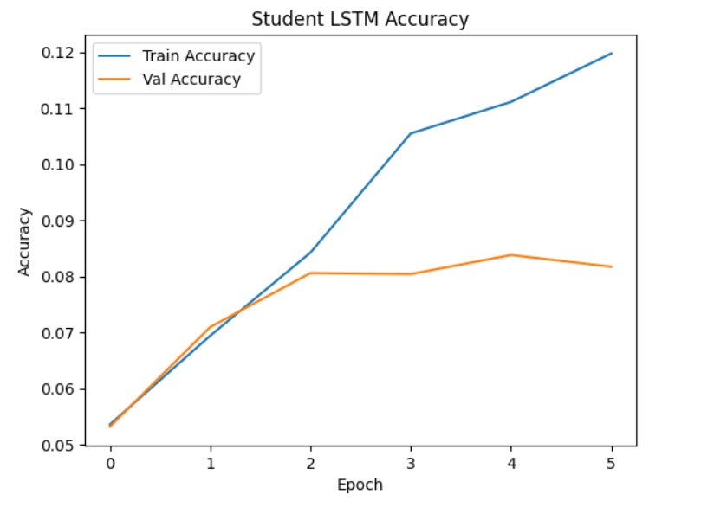
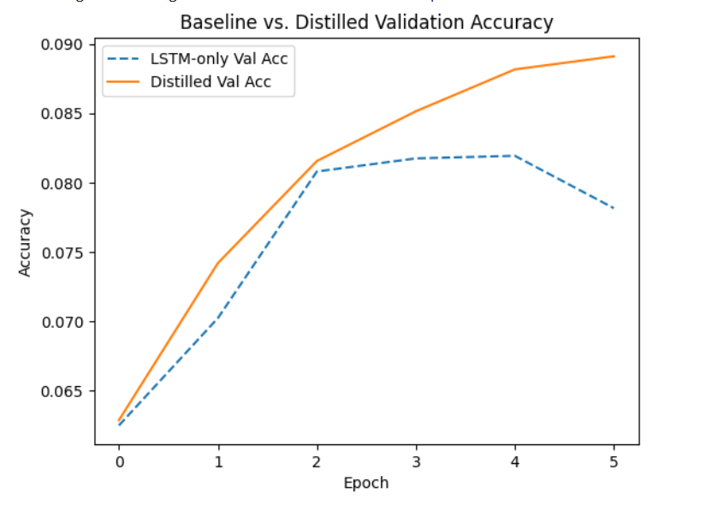
Results

Slide 9
Applications
IoT & Edge Devices: Run language models on low-power hardware with limited memory.
Offline Virtual Assistants: Enable smart input and responses without cloud access.
Mobile Autocompletion: Power predictive keyboards and text input efficiently.
Low-Bandwidth Scenarios: Perform on-device inference where connectivity is limited.

Slide 10
Future Work
Model Optimization
The low validation accuracies suggest potential improvements through hyperparameter tuning, alternative architectures, or larger datasets.
Enhanced Evaluation
Future work could explore top-k accuracy or perplexity for a more comprehensive evaluation, enhancing model robustness.

Slide 11

Thank You!

